Slide 1
IBM University Engagement Project Submission
AI Agent for Digital Financial Literacy (FinSaathi)
“Exploring the Power of IBM Granite and RAG on watsonx.ai”

Slide 2

Project Title – AI Agent for Digital Financial Literacy
Domain of Project – Finance / Education (FinTech)
Student Name | Recent Passport Photo | Email ID | Mobile number [WhatsApp]
VEMULA NILESH |  | nileshreddy150@gmail.com | 6303325834

Slide 3
Problem Statement -
Problem Statement: AI Agent for Digital Financial Literacy
The Challenge
Millions of people now use UPI and mobile banking, often without guidance on safe use. Scams, phishing and unaffordable loans hit first-time and vulnerable users hardest. Trusted guidance is scattered across portals, written in jargon and often only in English.
The Objective
Build an AI agent, powered by RAG and IBM Granite, that gives simple, trustworthy, multilingual guidance on digital finance. The solution:
Practical Q&A – Answers questions like “How do I send money via UPI?” and “What is a safe interest rate for a loan?”
RAG over Trusted Sources – Retrieves from curated RBI, NPCI, SEBI, IRDAI, Income Tax and Cyber Dost content and cites the sources.
Scam & Fraud Awareness – Explains UPI, phishing and social-engineering scams and points to the 1930 cyber-crime helpline.
Budgeting & Money Basics – Covers budgeting, savings, interest rates, credit score, insurance, investments and tax.
Multilingual – Auto-detects 11 languages (English, Hindi, Tamil, Telugu and more) and replies in the user’s language.
Safe by Design – Answers only from retrieved context; no stock tips or guaranteed returns.

Slide 4
Proposed Solution -
Proposed Solution: RAG-based Multilingual Financial Literacy Agent
FinSaathi is a RAG-powered assistant built with FastAPI, LangChain, IBM watsonx.ai and IBM Granite. It explains money management in simple language, answers from trusted sources and helps users stay safe in digital transactions.
Curated RBI, NPCI, SEBI, IRDAI and government content (13 documents) is chunked, embedded with Granite multilingual embeddings and stored in ChromaDB, so Granite answers with grounded, cited information instead of guessing.
Pipeline stages:
Language Layer – detects the user’s language and translates the query to English (IBM Watson Translator, deep-translator fallback).
Question Condenser – rewrites follow-up questions into standalone questions using chat history.
RAG Retriever – fetches the top-5 matching chunks from ChromaDB.
Granite Generator – granite-4-h-small on watsonx.ai writes the answer, which is translated back and shown with its sources.
A chat UI calls the FastAPI /chat endpoint. The agent gives education, not regulated investment advice.

Slide 5
Technology Used
FastAPI + Uvicorn – REST backend (/chat, /health, /topics, /languages) with rate limiting.
IBM Granite model – ibm/granite-4-h-small on watsonx.ai for grounded, plain-language answers.
IBM watsonx.ai – hosts Granite generation and Granite multilingual embeddings.
IBM Cloud Lite – free-tier watsonx.ai and Watson Language Translator services; Docker and Procfile for deployment.
RAG with LangChain – retrieve verified content first, then generate; this reduces misinformation.
ChromaDB – vector store using ibm/granite-embedding-278m-multilingual for semantic retrieval.
HTML / CSS / JS – lightweight chat UI with topic shortcuts and language selection.

Slide 6
Key components used -
1) Chat UI – frontend/index.html: users ask in any supported language and pick quick-access topics.
2) FastAPI routes – app/api: validate requests and return the answer, sources and detected language.
3) Translator – app/i18n: language detection, IBM Watson Translator with deep-translator fallback.
4) IBM Granite LLM – app/agent/granite_llm.py: granite-4-h-small via the watsonx.ai SDK, temperature 0.3.
5) Vector store – app/rag: ChromaDB with Granite multilingual embeddings over 13 curated documents.
6) Prompts & RAG chain – app/agent: persona and safety rules, question condensing, context-grounded answer.

Slide 7
Application workflow -
1. User query
Any of 11 languages
2. Detect & translate
langdetect → English
3. Condense
Follow-up → standalone
4. Retrieve
ChromaDB top-5 chunks
5. Generate
Granite on watsonx.ai
6. Reply
Translated answer + sources
Knowledge base
13 RBI · NPCI · SEBI · IRDAI docs
Example: “UPI से पैसे कैसे भेजें?” → language detected: hi → English query “How to send money via UPI?” → NPCI UPI document retrieved → Granite writes the answer → translated to Hindi and shown with its source.

Slide 8
Architecture blueprint
USER LAYER
PIPELINE (FastAPI + LangChain + watsonx.ai)
KNOWLEDGE & DATA
Language Layer
detect + translate
Embeddings
granite-embedding-278m-multilingual
User
Any of 11 Indian languages
FastAPI Backend
POST /chat
rag_chain.py
Question Condenser
follow-ups
Knowledge base
13 RBI · NPCI · SEBI · IRDAI docs
Chat UI
HTML / CSS / JS
RAG Retriever
top-5 from ChromaDB
Session history
sent by the UI; not stored
Answer + sources
translated to user language
IBM Granite LLM
granite-4-h-small
IBM Cloud Lite | watsonx.ai

Slide 9

Role of Agentic AI in the solution
Role of Agentic AI in FinSaathi
Step-by-step workflow: the agent detects the language, rewrites follow-ups, retrieves evidence and only then composes the answer with Granite.
Grounding: answers come from retrieved RBI, NPCI and SEBI content, and the agent says so when the context has no answer.
Context awareness: chat history and the detected language shape each reply.
Safety guardrails: no stock tips or guaranteed returns; fraud questions point to the 1930 helpline.
Overall, it behaves like a patient digital money mentor that is trustworthy, multilingual and easy to use.

Slide 10
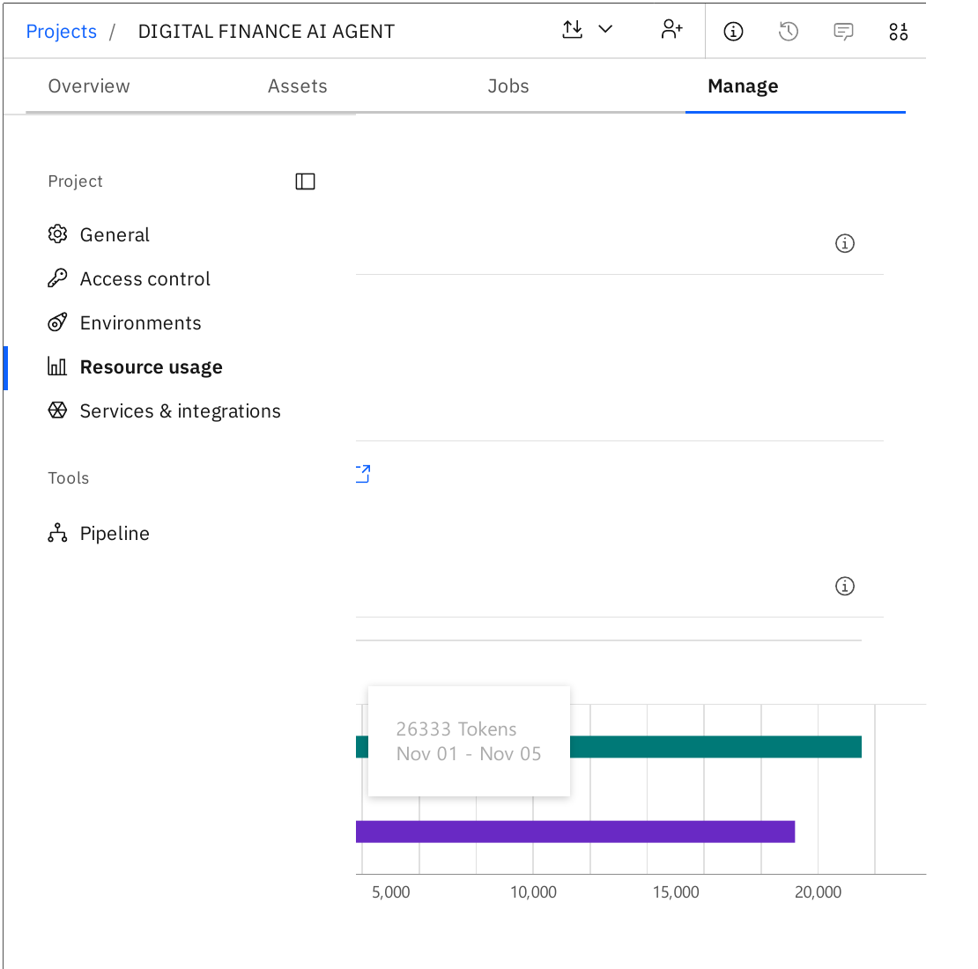
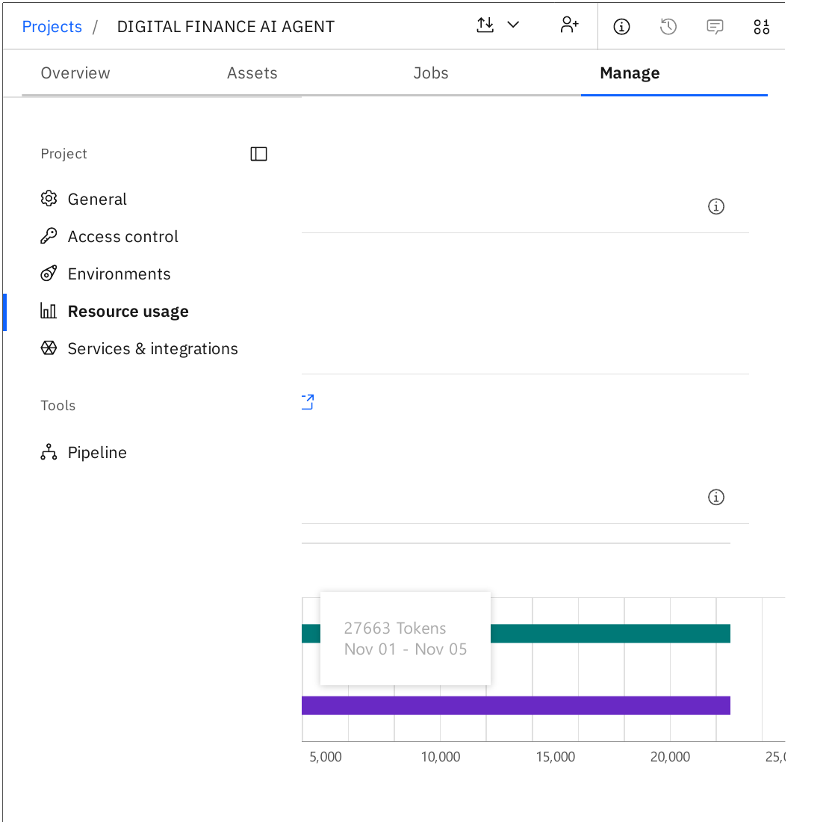
Token Usage
1,330 tokens used by the prompt (Prompt Lab: 26,333 → 27,663 tokens, from watsonx.ai Resource usage)
Before Prompt
After the Prompt

Slide 11
Novelty and Uniqueness
FinSaathi combines RAG, IBM Granite and multilingual access to make money education practical and safe.
Trusted, Cited Answers – RAG over official RBI, NPCI, SEBI and IRDAI content shows sources and reduces misinformation.
Built for India – covers UPI, CIBIL, Jan Dhan, MUDRA, APY and Indian tax basics.
Fraud Awareness Built In – teaches users to spot UPI and phishing scams and where to report them (1930).
11 Indian Languages – detects and replies in the user’s language, removing the English-only barrier.
Safe and Honest – answers only from context, admits gaps and never gives stock tips.
Enterprise-Ready – built on Granite and watsonx.ai, runs on IBM Cloud Lite with Docker support.
It acts as a patient, always-available money mentor, not a static article library.

Slide 12
Git Hub Link
GitHub URL – https://github.com/nileshreddy150/digital-financial-ai-agent
RENDER DEPLOY LINK – https://digital-financial-ai-agent.onrender.com

Slide 13
Future Scope
1. Voice Input and Regional Speech –
Speaking questions and hearing answers in Indian languages will help first-time digital users who prefer not to type.
2. Budget Planner and Quizzes –
Users enter income and expenses to get a monthly plan and savings goals, with quizzes that track literacy progress.
3. Real-Time Scam Detection –
Checking suspicious messages, links and payment requests live, and guiding users to report to the right authorities.

Slide 14
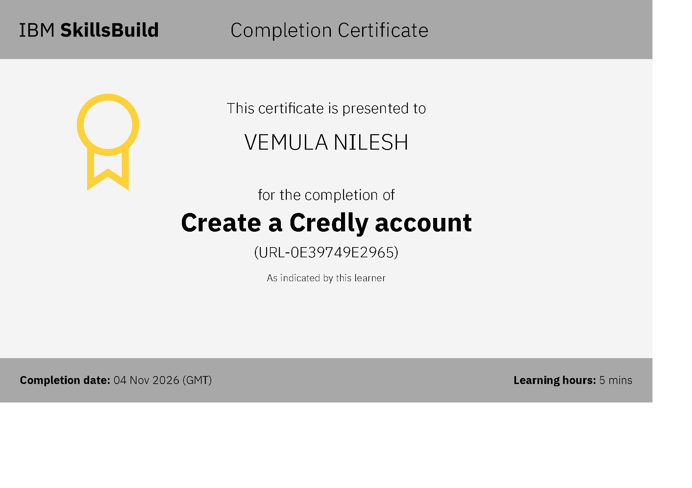
Certificates Earned:
Please add your credly certificate

Slide 15
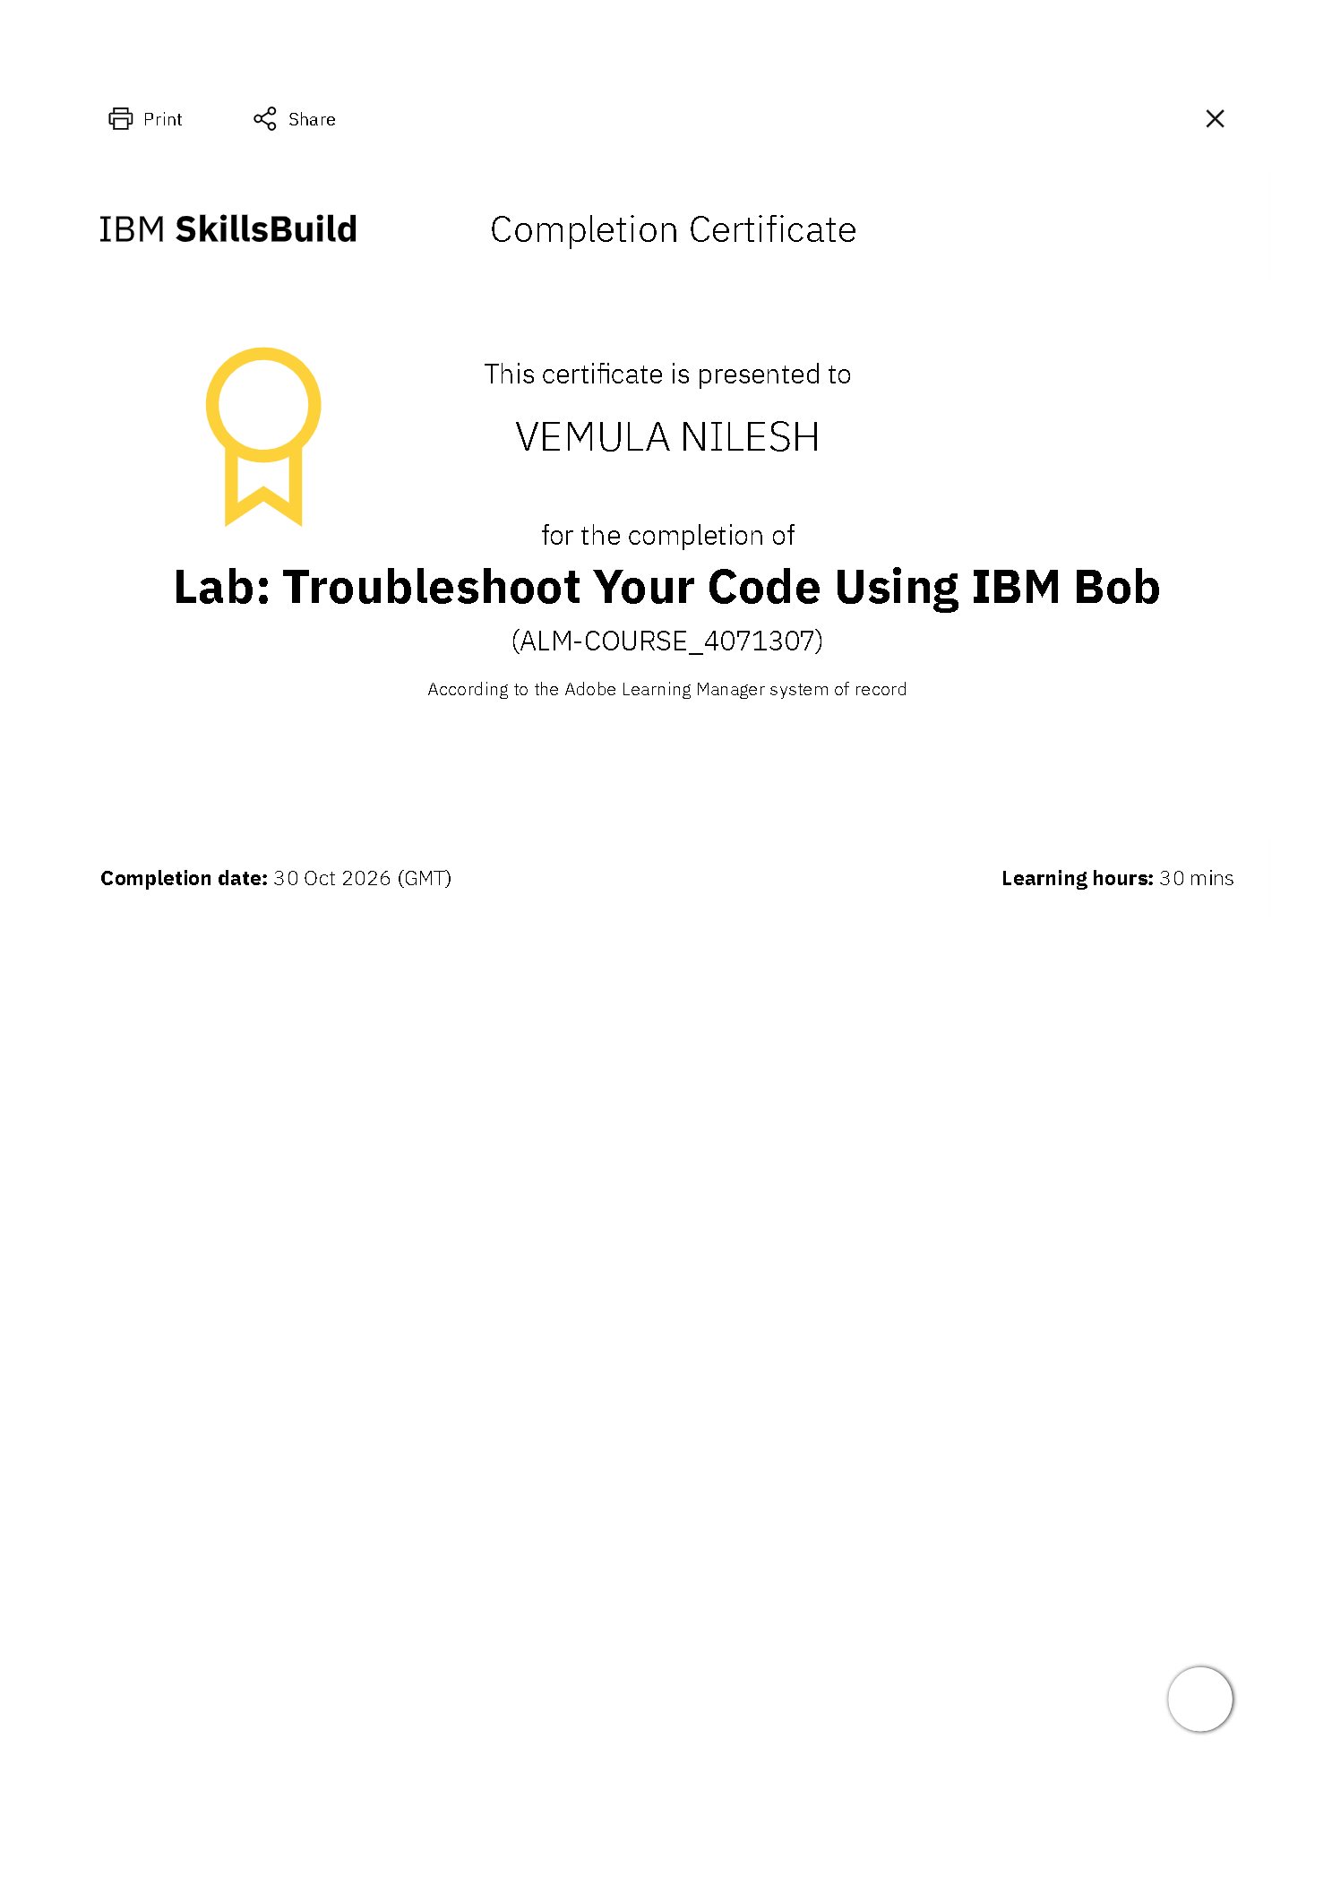
Certificates Earned:​
Add your IBM BOB Certificate

Slide 16


